Slide 1
CHAPTER 2
ALGORITHM ANALYSIS
【Definition】An algorithm is a finite set of instructions that, if followed, accomplishes a particular task. In addition, all algorithms must satisfy the following criteria:
(1) Input There are zero or more quantities that are externally supplied.
(2) Output At least one quantity is produced.
(3) Definiteness Each instruction is clear and unambiguous.
(4) Finiteness If we trace out the instructions of an algorithm, then for all cases, the algorithm terminates after finite number of steps.
(5) Effectiveness Every instruction must be basic enough to be carried out. It is not enough that each operation be definite as in(3); it also must be feasible.
Notes:
Algorithm analysis is a important point in textbook, but is not in our course, we will omit many contents about algorithm analysis But we need learn something about it for better understanding of textbook.

Slide 2
Note: A program is written in some programming language, and does not have to be finite (e.g. an operating system).
An algorithm can be described by human languages, flow charts, some programming languages, or pseudo-code.
〖Example〗 Selection Sort: Sort a set of n ≥ 1 integers in increasing order.
From those integers that are currently unsorted, find the smallest and place it next in the sorted list.
Where and how
are they stored?
for ( i = 0; i < n; i++) {
Examine list[i] to list[n−1] and suppose that the smallest integer is at list[min];
Interchange list[i] and list[min];
}
Where?
Algorithm in
pseudo-code
Sort = Find the smallest integer + Interchange it with list[i].
Notes:
9.26
So what is different between program and algorithm, actually we write program according algorithm, program is implementation of algorithm, algorithm is more logic and abstract, and program is more detail.

Slide 3
§1 What to Analyze
➢ Machine & compiler-dependent run times.
➢ Time & space complexities : machine & compiler-independent.
Assumptions:
① instructions are executed sequentially
② each instruction is simple, and takes exactly one time unit
Typically the following two functions are analyzed:
T_{avg}(N) & T_{worst}(N) -- the average and worst case time complexities, respectively, as functions of input size N.
If there is more than one input, these functions may have more than one argument.
Notes:
What do we analyze? We analyze Efficiency of program, how long does it run, how many memory space does it use.
Usually there are two analysis(or evaluation) method: pre and post. In post method, loss may be great.
In our course, we mainly concern time complexity

Slide 4
§1 What to Analyze
〖Example〗 Matrix addition
void add ( int a[ ][ MAX_SIZE ],
int b[ ][ MAX_SIZE ],
int c[ ][ MAX_SIZE ],
int rows, int cols )
{
int i, j ;
for ( i = 0; i < rows; i++ )
for ( j = 0; j < cols; j++ )
c[ i ][ j ] = a[ i ][ j ] + b[ i ][ j ];
}
Q: What shall we do
if rows >> cols?
A: Exchange
rows and cols.
/* rows + 1 */
/* rows(cols+1) */
/* rows ⋅ cols */
T(rows, cols ) = 2 rows ⋅ cols + 2rows + 1
Notes:
9.18
If rows >> cols exchange rows and cols in program could decrease T

Slide 5

§2 Asymptotic Notation ( Ο, Ω, Θ, o )
The point of counting the steps is to predict the growth in run time as the N change, and thereby compare the time complexities of two programs. So what we really want to know is the asymptotic behavior of T_{p}.
Suppose T_{p1} ( N ) = c₁N² + c₂N and T_{p2} ( N ) = c₃N. Which one is faster?
No matter what c₁, c₂, and c₃ are, there will be an n₀ such that T_{p1} ( N ) > T_{p2} ( N ) for all N > n₀.
I see! So as long as I know that
T_{p1} is about N² and T_{p2} is about N, then for
sufficiently large N, P2 will be faster!
Notes:
渐近的Asymptotic
Θ:theta
When we do algthm analy. We do not want to calculate exactly run time, what we want to know is grow rate of run time against N(number of data).

Slide 6
§2 Asymptotic Notation
【Definition】 T (N) = O( f (N) ) if there are positive constants c and n₀ such that T (N) ≤ c ⋅ f (N) for all N ≥ n₀.
【Definition】 T (N) = Ω( g(N) ) if there are positive constants c and n₀ such that T (N) ≥ c ⋅ g(N) for all N ≥ n₀.
【Definition】 T (N) = Θ( h(N) ) if and only if T (N) = O( h(N) ) and T (N) = Ω( h(N) ) .
【Definition】 T (N) = o( p(N) ) if T (N) = O( p(N) ) and T (N) ≠ Θ( p(N) ) .
Note:
➢ 2N + 3 = O( N ) = O( N^{k≥1} ) = O( 2^{N} ) = ⋅⋅⋅ We shall always take the smallest f (N).
➢ 2^{N} + N² = Ω( 2^{N} ) = Ω( N² ) = Ω( N ) = Ω( 1 ) = ⋅⋅⋅ We shall always take the largest g(N).
Notes:
Here is some Asymptotic notations used in textbook
The 1st definition says that the growth rate of T(N) is less than or equal to that of f(N)
The 2nd definition says that the growth rate of T(N) is greater than or equal to that of g(N)

Slide 7


§2 Asymptotic Notation
Rules of Asymptotic Notation
☞ If T₁ (N) = O( f (N) ) and T₂ (N) = O( g(N) ), then
(a) T₁ (N) + T₂ (N) = max( O( f (N)), O( g(N)) ),
(b) T₁ (N) * T₂ (N) = O( f (N) * g(N) ).
☞ If T (N) is a polynomial of degree k, then T (N) = Θ( N ^{k} ).
☞ log^{k} N = O(N) for any constant k. This tells us that logarithms grow very slowly.
Note: When compare the complexities of two programs asymptotically, make sure that N is sufficiently large.
For example, suppose that T_{p1} ( N ) = 10⁶N and T_{p2} ( N ) = N². Although it seems that Θ( N² ) grows faster than Θ( N ), but if N < 10⁶, P2 is still faster than P1.

Slide 8

§2 Asymptotic Notation
2^{n}
n²
n log n
f
n
Log n
n
Notes:
This diagram shows the growth rate of different function

Slide 9
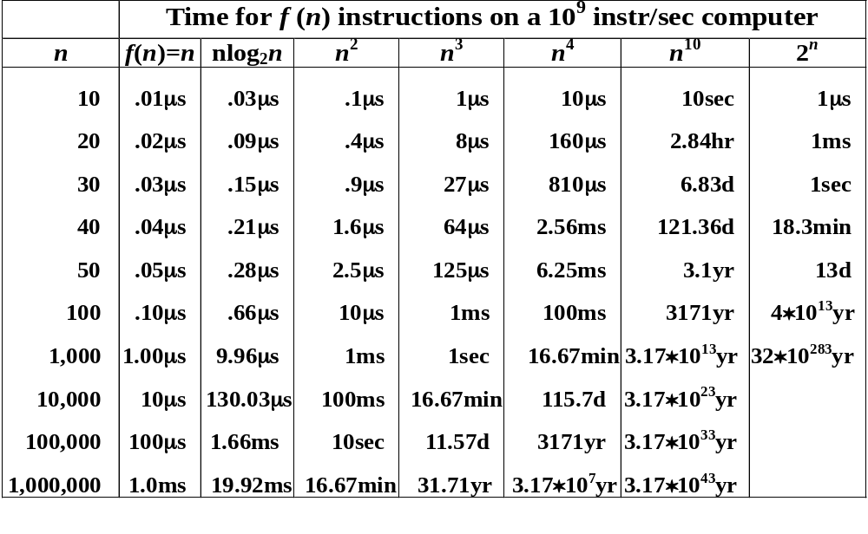
§2 Asymptotic Notation
μs = microsecond = 10⁻⁶ seconds
ms = millisecond = 10⁻³ seconds
sec = seconds
min = minutes yr = years
hr = hours
d = days
Notes:
This table shows run time for different time complexity, it shows when n is small, there is no serious problem, but when n get bigger, the problem get serious. So we must careful when design algorithm.

Slide 10
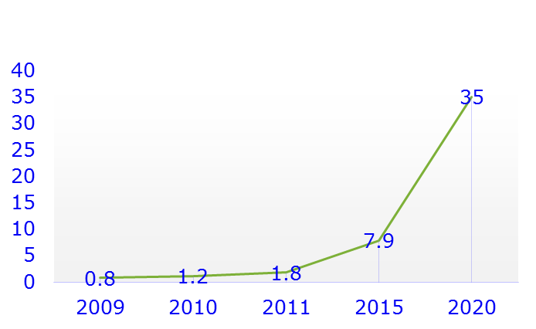
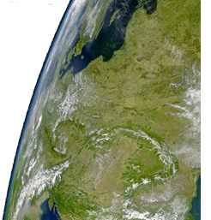

大数据时代的来临
人类产生的数据正在爆炸性的增长，迄今为止生成的数据中，有90％是在近两年内产生的，我们正在步入一个大数据的时代
2011年，人类共产生了1.8ZB（泽字节）数据
IDC到2020年，一年将生成35ZB
计算机存储单位一般用B，KB，MB，GB，TB，PB，EB，ZB，YB，BB来表示
35ZB （泽）的数据全部刻录到容量为9GB 的光盘上，其叠加的高度相当于在地球与月球之间往返三次
Notes:
2011年，人类共产生了1.8ZB（泽字节）数据
IDC到2020年，一年将生成35ZB
计算机存储单位一般用B，KB，MB，GB，TB，PB，EB，ZB，YB，BB来表示，它们之间的关系是：
1KB (Kilobyte 千字节)=1024B=10^3
1MB (Megabyte 兆字节 简称“兆”；万进级计数法中是“百万”字节；)=1024KB=10^6
1GB (Gigabyte 吉字节 又称“千兆”；万进级计数法中是“十亿”字节)=1024MB=10^9
1TB (Trillionbyte 太字节；万进级计数法中是“兆”字节)=1024GB=10^12
1PB（Petabyte 拍字节；万进级计数法中是“千兆”字节）=1024TB=10^15
1EB（Exabyte 艾字节；万进级计数法中是“百京”字节）=1024PB=10^18
1ZB (Zettabyte 泽字节；万进级计数法中是“十垓”字节)= 1024 EB=10^21
1YB (Yottabyte 尧字节；万进级计数法中是“秭”字节)= 1024 ZB=10^24
1BB (Brontobyte 万进级计数法中是“千秭”字节)= 1024 YB=10^27^{[1]}
^{j}
全球每秒钟发送 2.9 百万封电子邮件，一分钟读一篇的话，足够一个人昼夜不息的读5.5 年…
每天会有 2.88 万个小时的视频上传到Youtube，足够一个人昼夜不息的观看3.3 年…
推特上每天发布 5 千万条消息，假设10 秒钟浏览一条信息，这些消息足够一个人昼夜不息的浏览16 年…
每天亚马逊上将产生 6.3 百万笔订单…
每个月网民在Facebook 上要花费7 千亿分钟，被移动互联网使用者发送和接收的数据高达1.3EB…
Google 上每天需要处理24PB 的数据…
数据增长速度与it界的摩尔定律很类似，社交网络、物联网、电子商务，35ZB 的数据全部刻录到容量为9GB 的光盘上，其叠加的高度将达到233 万公里，相当于在地球与月球之间往返三次，全球在2010 年正式进入ZB 时代，预计到2020 年，全球将总共拥有35ZB 的数据量。我们正处于大数据时代的边缘。
85%的数据属于广泛存在于社交网络、物联网、电子商务等之中的非结构化数据,如今的数据类型早已不是单一的文本形式，订单、日志、音频，能力提出了更高的要求

